Slide 1
U.S. Department of Defense Contract Spending and Industrial Base: Highlights relevant to U.S.-ROK Strategic Cooperation of Defense Acquisition January 22, 2015
Gregory Sanders, Fellow
Drawing from research conducted with: David Berteau, Jesse Ellman, Rhys McCormick, Joshua Archer, Sam Brothers, Roy Levy, Daniel Massey, and Adam Schwartzman.
Project Director: Andrew Hunter
Defense-Industrial Initiatives Group
Center for Strategic & International Studies
Notes:
14:05 0 minutes 1:30
Thank you for having me, I’m delighted to have this opportunity. Specific thanks to our moderator Dr. Cha of the Korea Chair and KIET President Kim Do-hoon for sponsoring this conference, as well as Dir. Jang, Won-Joon and Dr. Ann, Young Su for their past work for my program and for their partnership on a forthcoming report.
My talk today has two purposes: 1) To detail the state of the U.S. defense acquisition system.
2) To discuss the implications for U.S.-RoK partnership.

Slide 2
U.S. Defense Contracting Spending
The Federal Procurement Data System (FPDS) was the primary source for the following slides report.
Federal regulations only require that all unclassified prime contracts worth $3,000 and above be reported to FPDS.
FPDS data are constantly being updated, including those for back years. As a consequence, the dollar totals for a given year can vary between reports.
Contract classifications sometimes differ between FPDS and individual companies, resulting in some contracts that a company considers as services being labeled as products by FPDS and vice versa.
OCO and supplementals are not separately classified in FPDS.
All dollar figures are in constant 2013 dollars
Additional charts (with breakdowns by DoD component and by Products/Services/R&D), along with full data tables, are available online at http://www.csis.org/NSPIR/DoD
The following slides draw heavily on the 2013 Defense Contracting Trends report and the work of my co-author Jesse Ellman.
Notes:
14:10 5:15 minutes 1:30 seconds
The next section of the talk focuses specifically on U.S. obligations to defense contractors tracked via the Federal Procurement Data System. These slides use fiscal year and 2013 constant dollars. The data on this topic is detailed but has several important restrictions:
These are prime contract obligations, subcontract obligation reporting is still largely unreliable.
Classified spending can go unreported.
OCO and base budget spending are both included but not differentiated.
Labeling will vary between the government and vendors and even between different parts of the government.
See the latest CSIS Defense Contract Trends report that I have published with co-author Jesse Ellman and our website for more details.

Slide 3
U.S. Department of Defense (DoD) Decline in Contract Obligations in Context, 2000-2013
Source: FPDS, Office of Management and Budget, NSPIR Analysis
Notes:
14:12 6:45 minutes 1:15 seconds
In this slide, we compared the effect of sequestration cuts in 2013 on overall defense outlays and on defense contracting in particular. We went to a great deal of work to compare apples-to-apples, that I will not discuss here, see the methodology of our latest report for the details.
Defense funded contract obligations fell by 16% from 2012 to 2013. This is twice as fast as cuts in total defense gross outlays. As a result defense funded contract obligations went from a 53 percent share to a 49 percent share of outlays.
As I discussed earlier with budgets, the affects of cuts on acquisition can be greater than top level spending suggests.

Slide 4
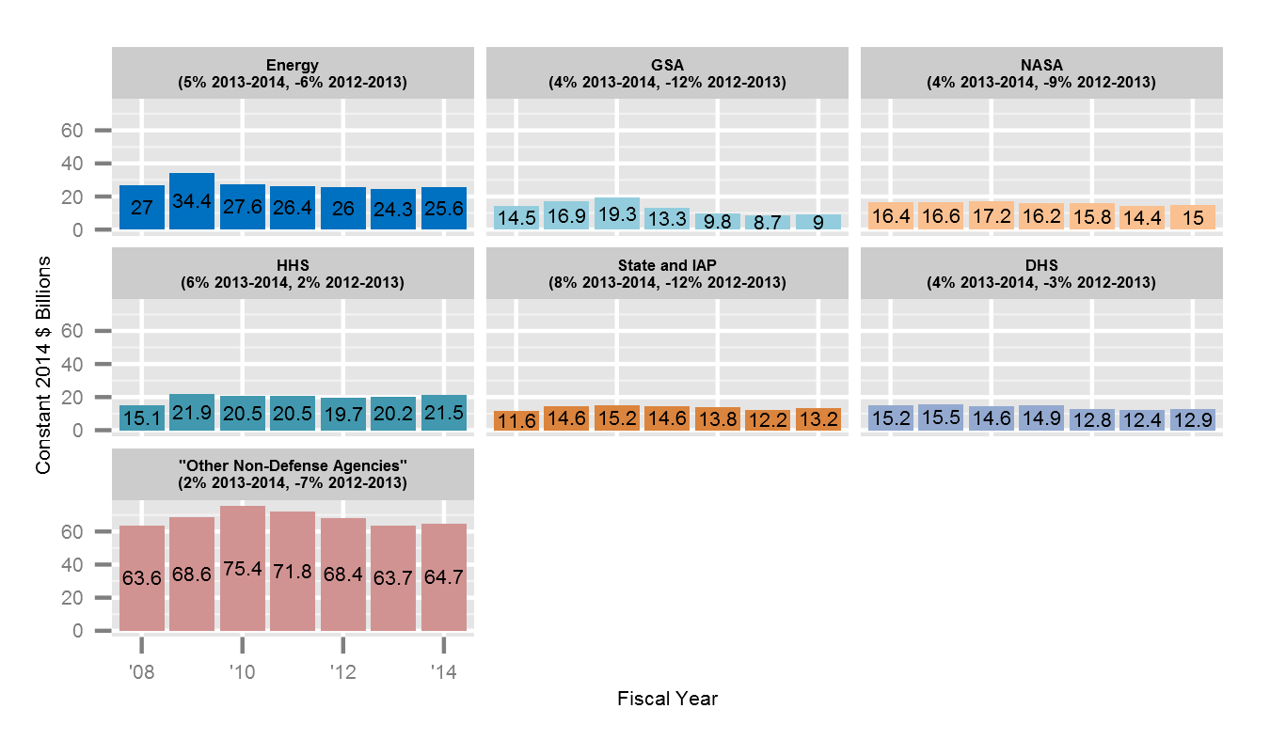
Non-Defense Contract Obligations by Customer, 2008-2014

Slide 5
DoD Contract Obligations by Component, 2000-2013
Source: FPDS, NSPIR Analysis
Notes:
14:13 8:00 minutes 1:00 seconds
Cuts during drawdown have fallen most heavily on Army contract spending has been cut most heavily since 2009.
Air Force cuts were smaller, but during sequestration it took a 22% reduction, greater than the 16% for DoD overall. Note that for the past several years, the Air Force has less contract obligations than do the Defense Logistics Agency and other DoD-wide agencies combined.
Navy did take earlier cuts, but faced smaller reductions this past year.
However, all of these adjustments are volatile.

Slide 6
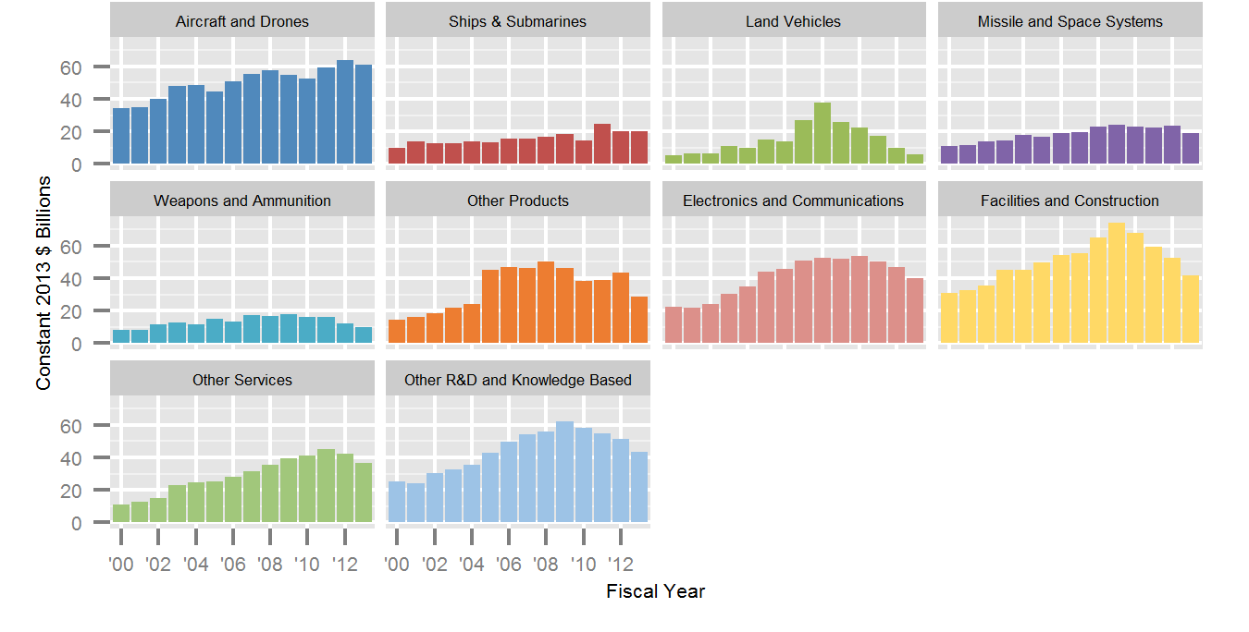
DoD Contract Obligations by Platform Portfolio, 2000-2013
Aircraft and Drones
Ships and Submarines
Land Vehicles
Missiles and Space
Weapons and Ammunition
Other Products
Electronics & Communications
Facilities & Construction
Constant 2013 $ Billions
Other Services
Other R&D & Knowledge Based
Developed by Rhys McCormick, in this chart each platform includes relevant contracts for products, services, and R&D.
Source: FPDS, NSPIR Analysis
Fiscal Year
Notes:
14:15 10:00 minutes 1:15 seconds
This chart categorizes contract obligations by platform portfolio, a methodology I developed with Rhys McCormick. Each small platform chart has the same scale and the same range of years. Unlike the last chart, the totals for platforms group together products, services, and R&D.
In the upper left, you can see that Aircraft and Drones are up, driven by the Joint Strike Fighter. One category to the right of that, Ships and Submarine spending is also stable, while most other categories are down.

Slide 7
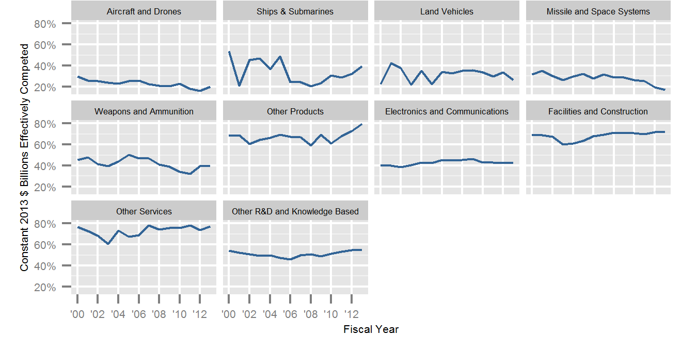
DoD Effective Competition Rates by Platform Portfolio, 2000-2013
Aircraft and Drones
Ships and Submarines
Land Vehicles
Missiles and Space
Weapons and Ammunition
Other Products
Electronics & Communications
Facilities & Construction
Percent of Contract Obligations Receiving 2 or More Offers
Other Services
Other R&D & Knowledge Based
Fiscal Year
Source: FPDS, NSPIR Analysis
Notes:
14:21 16:00 minutes 1:30 seconds
This chart returns to the platform portfolio breakdowns. Again the range of years and the percentage scale are the same for each small graphs. This time the y-axis is percentage of dollars being competed with two or more offers, “effective competition.”
Major platforms have low effective competition rates, but the details vary. Note that the aircraft and drones, as well as missile and space, the competition rat is getting worse. the rate for ships and submarine is slowly rising and may be returning to prior forty percent plus highs. Electronics and communications has also hovered around forty percent effectively competed, which is somewhat surprising given the greater applicability of commercial technology.

Slide 8
DoD Contract Obligations by Vendor Size, 2000-2013
Source: FPDS, NSPIR Analysis
Notes:
14:14 13:45 minutes 1:30 seconds
To analyze the breakdown of competitors in the market into small, medium, and large vendors, the CSIS team assigned each vendor in the database to one of four size categories. Any organization designated as small by the federal government—was categorized as such unless the vendor was a known subsidiary of a larger entity. Vendors with annual revenue of more than $3 billion, including from nonfederal sources, are classified as large. The Big 6 is a subset of “large”, separating out the six largest defense firms (Boeing, Lockheed Martin, Northrop Grumman, General Dynamics, Raytheon, and BAE). And medium is any contractor which qualifies as neither small nor large.
From 2009-2012, all categories took roughly proportional reductions, but The big-6 vendors suffered the smallest reductions in 2013 only taking a 9 percent cut. The next chart shows why that happened.

Slide 9
Policy Implications of U.S. DoD Drawdown for Foreign Acquisition Policy
There is a push for more global sourcing when appropriate.
However, significant barriers remains:
DoD contracting makes overwhelming use of U.S. vendors or U.S. affiliates of foreign vendors.
Any merger and acquisition activity that involves critical defense technologies or technology transfer will likely be examined by the Committee on Foreign Investment in the United States.
There are more opportunities at the subcomponent level, however there are also significant restraints aimed at maintaining security and reliability of supply.
The largest shifts in laws and policy are likely where the technology is most commercial and trust is present.
For traditional defense technology, the simplest approach is co-development or subcontracting work on systems where the United States and the Republic of Korea are already collaborating.
Notes:
14:23 18:00 minutes 1:00 seconds
This section of the presentation focus on what the U.S. defense budget situation means for foreign acquisitions.
Overall, the situation is more one of continuity than disruption. U.S. vendors and U.S. affiliates of foreign vendors have the vast majority of market share. Mergers and acquisitions and exports relating to high-end or critical defense technology are highly regulated. It is easier to sell into the sub-system market, but there are security regulations even there.
Foreign acquisition is most likely where the technology is most commercialized, where partnerships through co-development or sub-contracting are possible, and where the United States and the Republic of Korea are already collaborating.

Slide 10
International sourcing is part of how DoD seeks to expand competition
“Improve technology search and outreach in global markets. This new [Better Buying Power (BBP)] 3.0 initiative recognizes that the sources of a great deal of today’s technical innovation are not located in the United States. We have global allies, friends, and trading partners who share our values and can assist us in pursuing innovation and technological superiority. In addition, and where appropriate, products from non-U.S. sources may be adequate and less expensive than domestic products, freeing up resources for other priorities. Increased investments in cooperative research, co-development, and co-production may also provide better products for our warfighters at reduced cost
Frank Kendall, Under Secretary of Defense for Acquisition, Technology, & Logistics, Better Buying Power 3.0 announcement at CSIS September 19, 2014.
However, regulatory factors will continue to play a large Congressionally mandated role in this area.
Co-development of the Standard Missile 3 Block IIA project with Japan is an example of reaching abroad. The co-development involved no transfer of funds but the U.S. encouraged Japan to subsequently export to third parties (Kyodo News, 2009/10/25).
Notes:
14:24 19:00 minutes 0:45 seconds
Undersecretary of Defense for Acquisition, Technology, and Logistics Frank Kendall has increased emphasis on the importance of foreign defense acquisition in his Better Buying Power initiatives.
Note that he emphasizes innovation as much as cost savings. This is a large concern for the United States, particularly given the decline in R&D spending. However, he is working within existing Congressional mandates.

Slide 11
DoD Obligations to Sample Vendors with Overseas Parent Companies, 2000-2013
Note: Japanese Defense-Relevant Vendors include Fujitsu, Hitachi, IHI, Itochu, Kawasaki, Komatsu, Mitsubishi, Nippon Oil, NEC, and Toshiba.
Source: FPDS, NSPIR Analysis
Wartime needs, not drawdown seeking of efficiency or competition, were the largest driver for purchases from this sample.
DoD Industrial Base Assessments may be the best place to read open source evaluations of where needs area greatest.
Notes:
14:25 20:05 minutes 1:00 seconds
This chart looks at selected examples of vendors with foreign headquarters. Multiple subsidiaries have been rolled into parent vendors, with most of the revenue coming from U.S. affiliates. Remember that this is prime revenue only, so co-development and subcontract work may be reported under the U.S. partner instead.
If you look at the spikes, you’ll see that they almost all happened during war years. For the U.S. going abroad is often driven more by an immediate unmet need rather than by frugality. It is easiest to cut through the politics when there is a clear requirement that can be met overseas.

Slide 12
DOD also places emphasis on subcomponent competition
“Emphasize competition by creating and maintaining competitive environments… Competition is the most effective tool we have to control cost… When direct competition at the product level is not economically viable, then alternative means of introducing competitive pressure or direct competition at lower levels should be pursued.
Frank Kendall, Under Secretary of Defense for Acquisition, Technology, & Logistics, Better Buying Power 3.0 announcement at CSIS September 19, 2014.
“It is important to recognize that over the last 20 years, the industrial base upon which we rely has steadily become more global and diverse. Now, more than ever, we must accept that DoD does not control the supply chain that supports production.” - 2013 DoD Annual Industrial Capabilities Report to Congress
Notes:
14:27 22:05 minutes 0:30 seconds
At the sub-system level, Undersecretary Kendall has also emphasized competition, particularly when it is not available at the product level. The Department of Defense also recognizes, in the Annual Industrial Capabilities Reports, that the supply chains it relies on are already frequently global.

Slide 13
Common Themes in U.S. Defense Acquisition Reform
“Reform of defense acquisition – the goods as well as the services we buy – must be a top priority.” Rep. Mac Thornberry, Vice Chairman of the House Armed Services Committee and Chairman of the HASC Subcommittee on Intelligence, Emerging Threats and Capabilities
Acquisition reform must take advantage of innovation driven by commercial technologies
Administrative burden must be reduced in order to streamline acquisition
“The government gets in its own way from procuring commercial and “of a type” commercial items and services.”- 2014 New Democrat Coalition National Security Task Force, Defense Acquisition Reform Recommendations
Policy guidance must be supplied to acquisition officials in order to “ease the acquisition of commercial solutions”
Establishment of a “collaborative and data driven process for making commercial item determinations” is critical in “facilitating more rapid acquisition”
Notes:
14:29 23:45 minutes 1:00 seconds
Laws may change with regard to defense acquisition. The areas of great accord between the two U.S. political parties relate to commercial technologies and streamlined acquisition. Yet seeking innovation or even directly discussing the question of foreign acquisition, does not received the same level of emphasis.
In addition, given the polarized nature of U.S. politics, more broadly based reforms seem unlikely. Exceptions may happen through traditional channels on a case-by-case basis where lawmakers and regulators see a clear need.

Slide 14
There have been changes in the U.S. Export Control System in recent years have had the biggest impact for dual-use and commercial technology.
Recent initiatives as summarized by the Congressional Research Service (The U.S. Export Control System and the President’s Reform Initiative, R41916):
The President has proposed a variety of means to consolidate the system and “elements of a future single system such as the consolidated screening list and harmonization of certain licensing policies have been achieved.
“[T]he National Defense Authorization Act (NDAA) of 2013 (P.L. 112-239, January 2, 2013) included a provision to repeal Section 1513(a) of the Strom Thurmond NDAA of 1999, which removed satellites and related items from the Commerce Control List (CCL) and placed them on the U.S. Munitions List (USML).”
Other legislation, including an attempt to restore the expired Export Administration Act, was introduced in the 112th Congress but did not pass.
Notes:
14:29 23:45 minutes 1:00 seconds
Laws may change with regard to defense acquisition. The areas of great accord between the two U.S. political parties relate to commercial technologies and streamlined acquisition. Yet seeking innovation or even directly discussing the question of foreign acquisition, does not received the same level of emphasis.
In addition, given the polarized nature of U.S. politics, more broadly based reforms seem unlikely. Exceptions may happen through traditional channels on a case-by-case basis where lawmakers and regulators see a clear need.

Slide 15
Conclusions
The U.S. political and acquisition process is difficult to predict at this time, even for those of us in country.
While there is greater emphasis in the U.S. on competition, recent policy changes tend to be concerned with acquisition contracts that are more commercial rather than dealing with critical defense-specific technologies.
The Republic of Korea in the past has had positive externalities from defense production, but that is exceptional and defense spending can have crowding out effects on pure commercial exports (Uk Heo, Defense Spending and Export in South Korea: A Causal Analysis).
Thus, lowest risk opportunities from the drawdown focus on areas where U.S. DoD needs coincide with Republic of Korea defense priorities and greater commercial relevance (see DoD Annual Industrial Capabilities Reports).
For traditional weapon systems, the most straightforward way to take advantage of the increasing emphasis on competition is co-development or subcomponent agreements for systems where many of the regulatory hurdles have already been overcome.
Notes:
17:31 26:00 minutes 2:30 seconds
::Read text of slide::
Finally, I will add to remember that unlike the Republic of Korea’s past success with export driven growth, defense exports will always have a highly political aspect to them, even for markets like the United States where outright corruption is not a significant factor.
This will often complicate foreign acquisition, both in terms of competition with domestic vendors and for vendors from countries with more robust bilateral acquisition arrangements. However, politics can work in favor of foreign acquisition when it enhances common security goals, such increasing collaboration and interoperability among Asian allies and partners.

Slide 16
About CSIS
At a time of new global opportunities and challenges, the Center for Strategic and International Studies (CSIS) provides strategic insights and policy solutions to decisionmakers in government, international institutions, the private sector, and civil society. A bipartisan, nonprofit organization headquartered in Washington, DC, CSIS conducts research and analysis and develops policy initiatives that look into the future and anticipate change.
Founded by David M. Abshire and Admiral Arleigh Burke at the height of the Cold War, CSIS was dedicated to finding ways for America to sustain its prominence and prosperity as a force for good in the world.
Since 1962, CSIS has grown to become one of the world’s preeminent international policy institutions, with more than 220 full-time staff and a large network of affiliated scholars focused on defense and security, regional stability, and transnational challenges ranging from energy and climate to global development and economic integration.
Former U.S. senator Sam Nunn became chairman of the CSIS Board of Trustees in 1999, and John J. Hamre has led CSIS as its president and chief executive officer since April 2000
CSIS does not take specific policy positions; accordingly, all views expressed in this presentation should be understood to be solely those of the author(s).

